Slide 1




Credit EDA Documentation
Presented by:
Aarya Sawant
Kahan Bhatt
Shantil Khadatkar

Slide 2

Introduction
Business Understanding
Business Objectives
Importing Required Libraries
Reading Application_Data and Understanding the Dataset
Data checking and Missing values
Analysis
Reading Previous_Application Dataset
4. Conclusion

Slide 3




Slide 4


Business Understanding
The case study is about a consumer finance company that lends various types of loans to urban customers.
The company needs to use EDA to analyse loan application patterns and make sure that only applicants who are likely to repay the loan are approved.
Two types of risks are associated with loan approval: not approving a loan to someone who can repay it results in a loss of business, while approving a loan to someone who is likely to default results in a financial loss for the company.
The loan application data contains information about clients who have had payment difficulties in the past, and those who have not.
When a client applies for a loan, there are four possible decisions that could be made by the client or the company: Approved, Cancelled, Refused, and Unused offer.
The goal of the EDA is to understand how different consumer and loan
attributes affect the likelihood of default.

Slide 5
Business Objectives
The goal of this case study is to find out if a client may have trouble paying their loan installments, and to use this information to make decisions such as whether to deny the loan, reduce the loan amount, or charge a higher interest rate.
The company wants to identify patterns that can help them distinguish between clients who are likely to pay back their loan and those who are not.
By doing this, the company can make sure that they don't reject clients who are capable of repaying their loans while minimizing the risk of defaults.
Risk analytics is an important tool for understanding the types of variables that are strong indicators of default and for assessing risk in a company's loan portfolio.

Slide 6
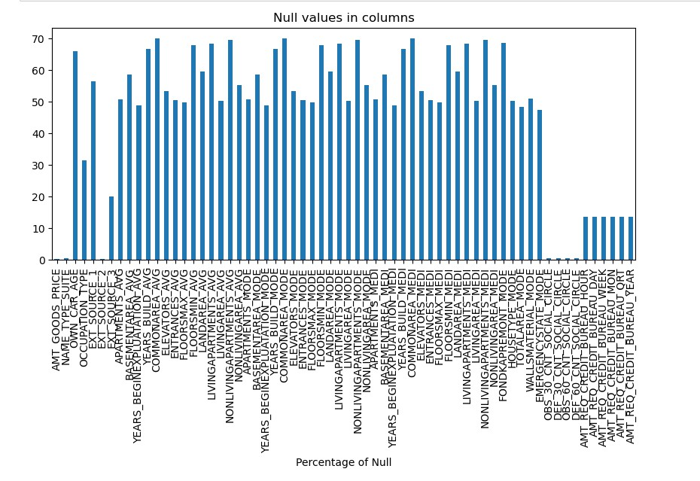

Slide 7

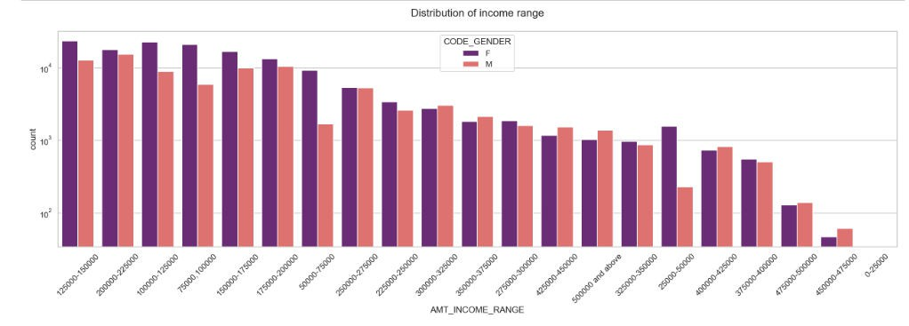
Female counts are higher than male.
Income range from 100000 to 200000 is having more number of credits.
This graph show that females are more than male in having credits for that range.
Very less count for income range 400000 and above.

Slide 8
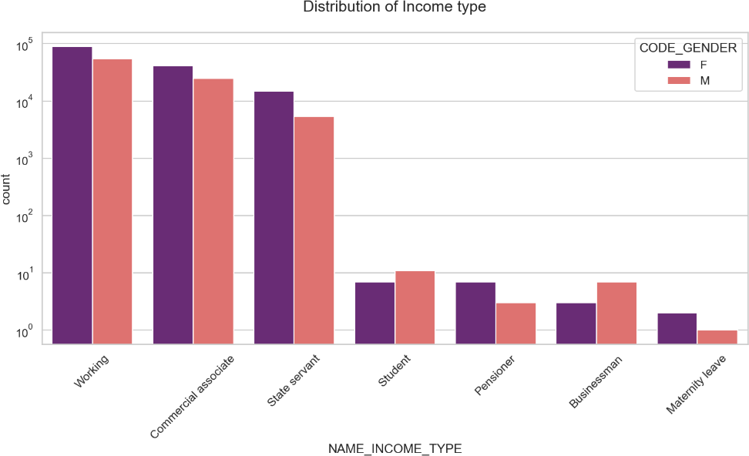
For income type ‘working’, ’commercial associate’, and ‘State Servant’ the number of credits are higher
than others.
For this Females are having more number of credits than male.
Less number of credits for income type ‘student’ ,’pensioner’, ‘Businessman’ and ‘Maternity leave’.

Slide 9
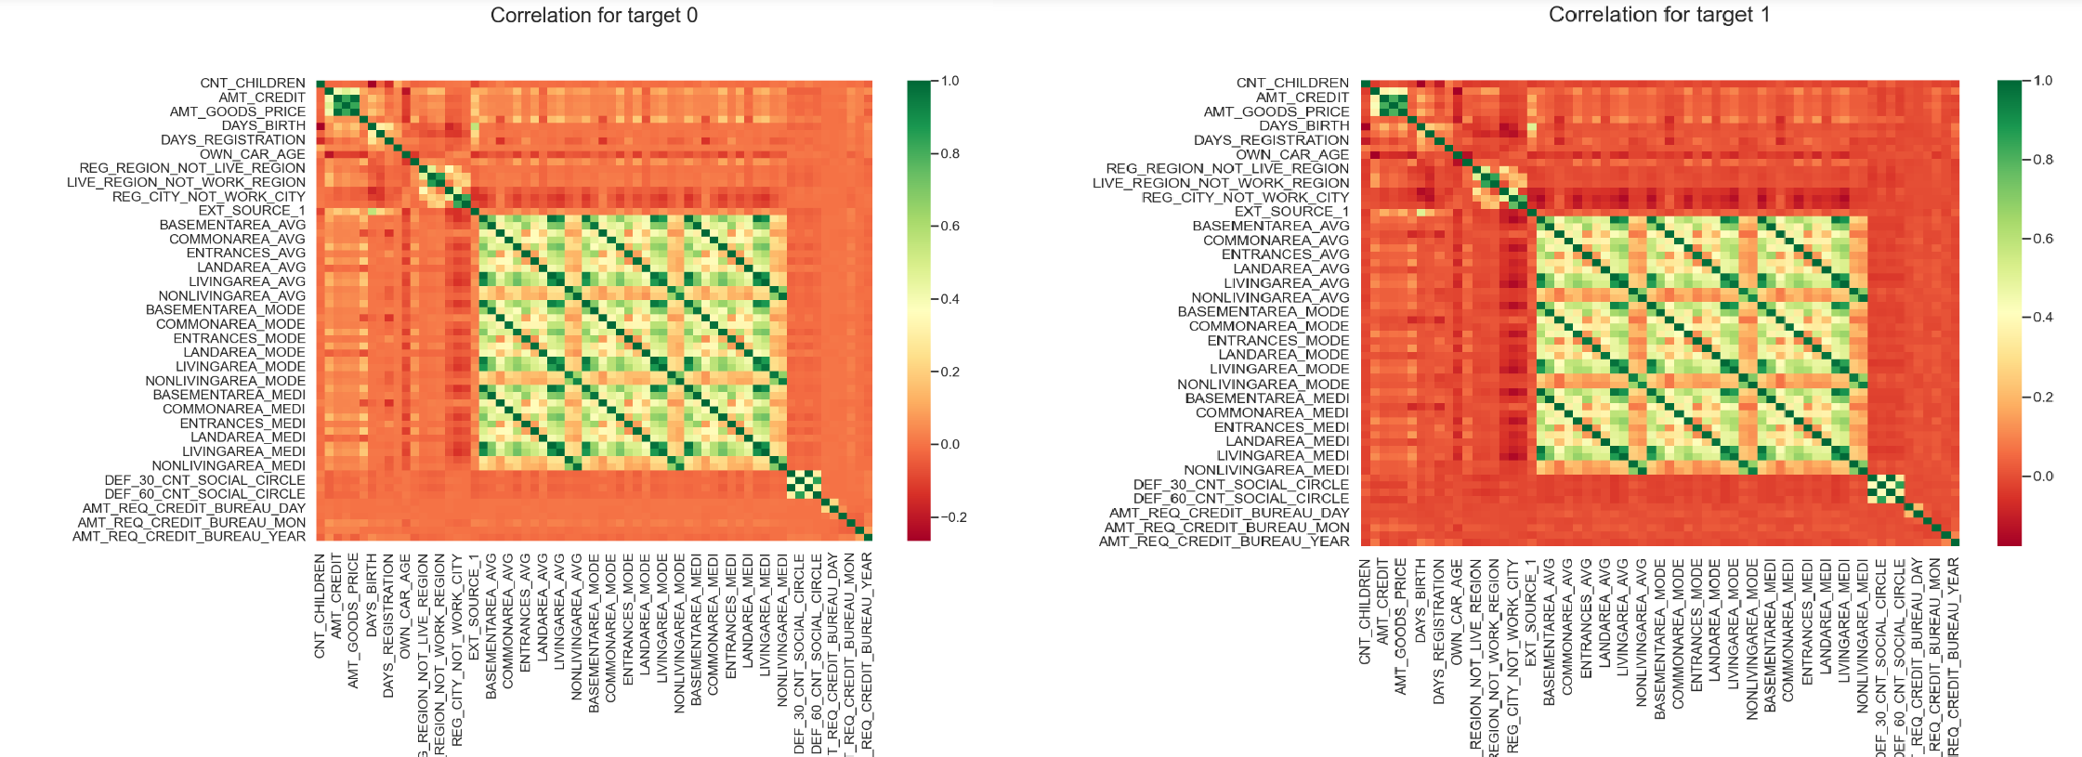
Credit amount is inversely proportional to the date of birth, which means Credit amount is higher for low age and vice-versa.
Credit amount is inversely proportional to the number of children client have, means Credit amount is higher for less children count client have and vice-versa.
Income amount is inversely proportional to the number of children client have, means
more income for less children client have and vice-versa.
The client's permanent address does not match contact address are having less children and vice-versa
the client's permanent address does not match work address are having less children and vice-versa

Slide 10
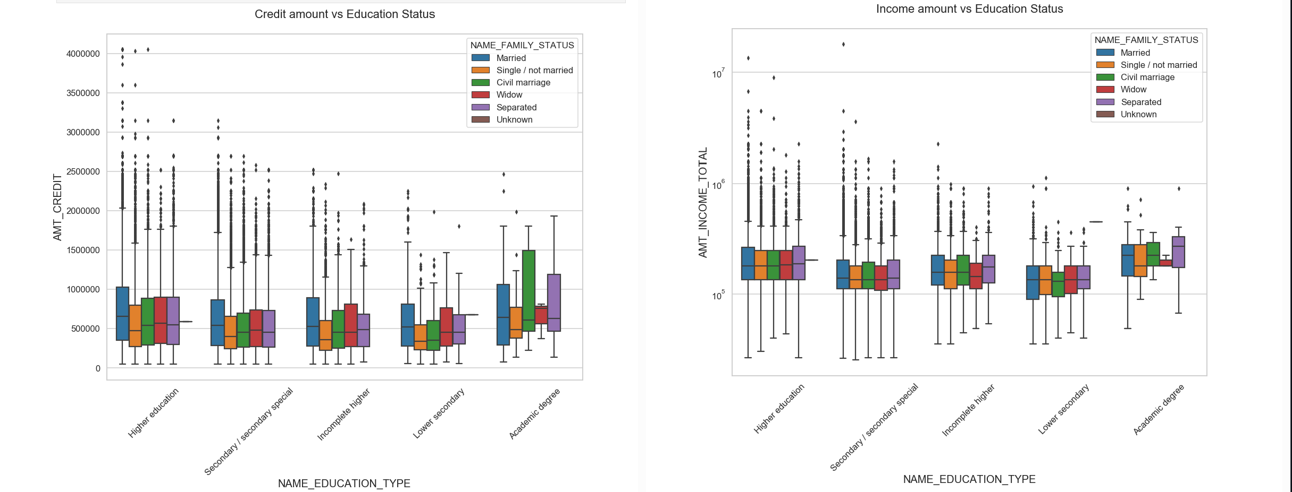
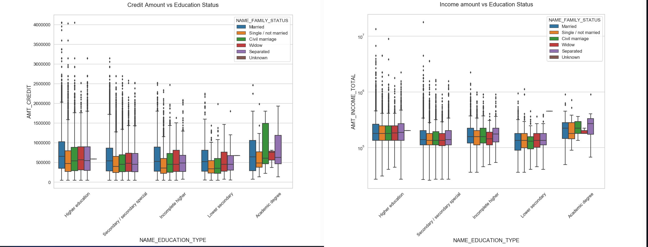

Slide 11
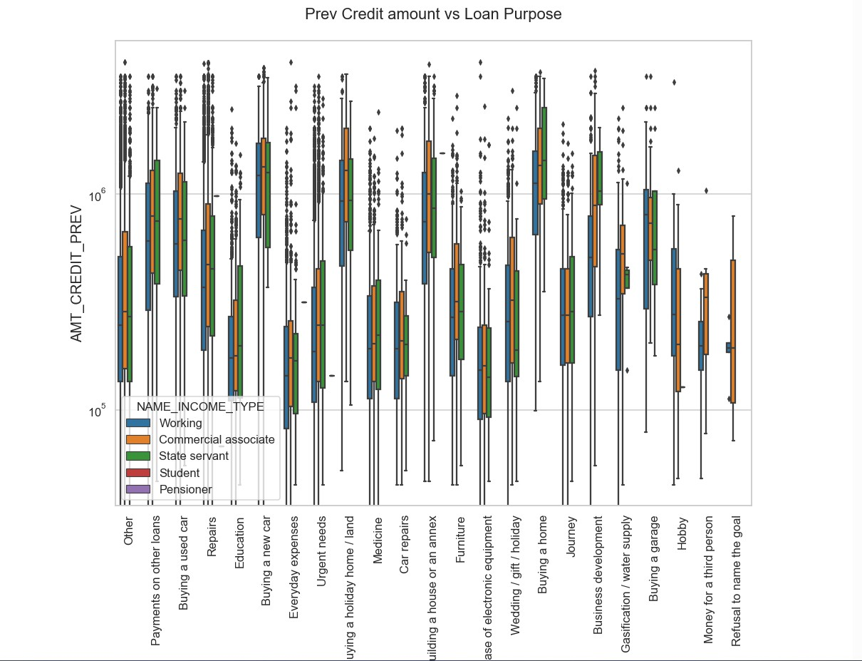
The credit amount of Loan purposes like 'Buying a home’, 'Buying a land’, 'Buying a new car' and 'Building
a house' is higher.
Income type of state servants have a significant amount of credit applied
Money for third person or a Hobby is having less credits applied for.

Slide 12

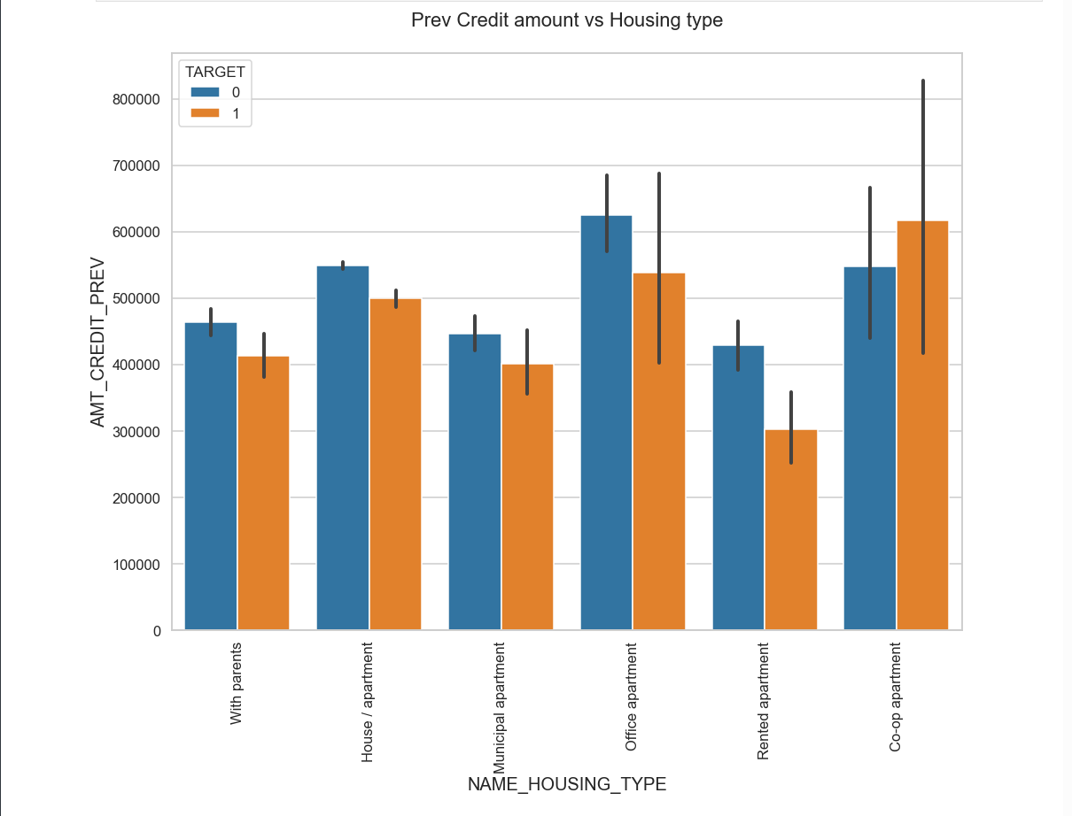
Here for Housing type, the office apartment is having higher credit of target 0 and theco-op apartment is having higher credit of target 1.
So, we can conclude that bank should avoid giving loans to the housing type of co-op apartment as they are having difficulties in payment.
The bank can focus mostly on housing type with parents or House/Apartment or municipal apartment for successful payments

Slide 13
Conclusion
The banks should focus more on contract type ‘Student’ ,’Pensioner’ and ‘Businessman’ with housing ‘type other than ‘Co-op apartment’ for
successful payments.
The banks should focus less on income type ‘Working’ as they are having most number of unsuccessful payments.
Also with loan purpose ‘Repair’ is having higher number of unsuccessful payments on time.
Get as much as clients from housing type ‘With parents’ as they are having least number of unsuccessful payments.

Slide 14
Thank
You !

